Slide 1

Application of Trajectory based Data for Analysis of Travel Time Variability
Fahmida Rahman

Slide 2
Project Statement
Evaluation of travel time variability
Selection of Probability Distribution for the variability
Assessment of the Level of Service (LOS) based on the concept of travel time reliability

Slide 3
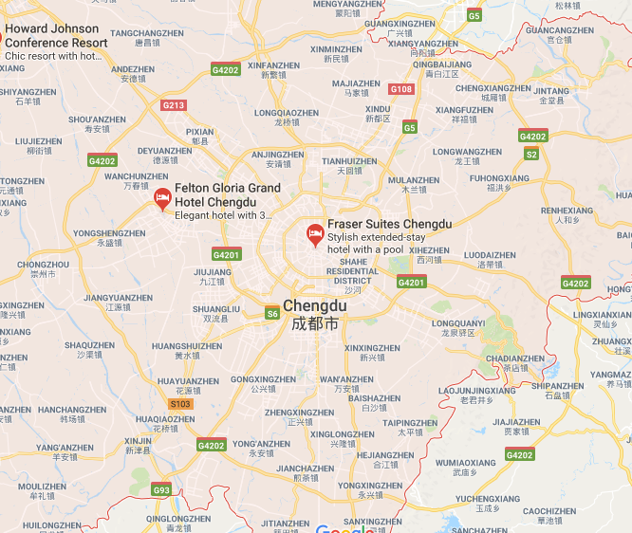
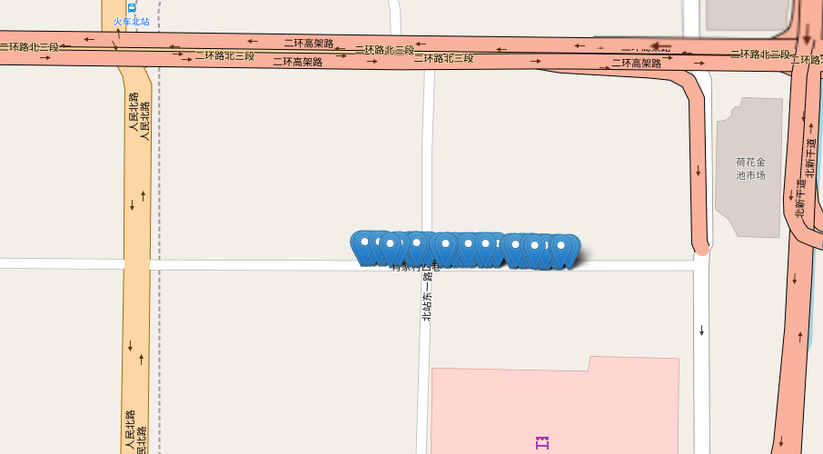
Study Corridor and Data Description
Data Source:
DiDi Datasets, Chengdu City, China.
Selected Corridor:
An Urban Corridor of almost
one of a mile.
Data Duration:
Nov 1st to Nov 15th, 2016.

Slide 4
Data Preparation
Exclude Negative Distance
ArcGIS
Map Matching
Exporting Matched Data
Python Analysis:
Get Distance
Aggregation of Speed for 5 min
Join Trj Data with Shapefile
Get Travel Time for each 5 min over The Day

Slide 5
Typical One Day Data

Slide 6
Distribution of Travel Time
Hypothesis Testing:
H0: the travel times statistically follow the probability distributions the mixture models.
H1: the travel times do not follow the distributions generated from the mixture models.
Mixture Models: Log Normal Distribution, Gamma Distribution.
One-sample Kolmogorov–Smirnov (K-S) Test using significance level of α =0.05

Slide 7
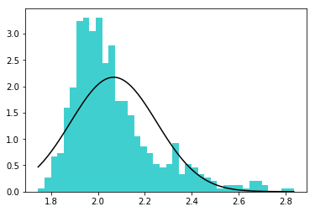
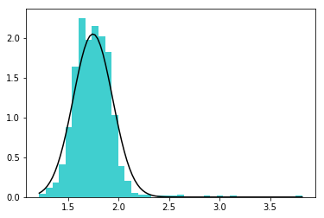
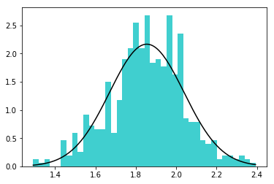
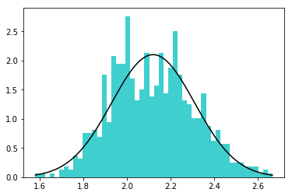
Lognormal vs Histogram of Travel Time
Morning Peak
x axis – travel time
Mid-day Peak
x axis – travel time
Evening Peak
x axis – travel time
Night time Peak
x axis – travel time

Slide 8
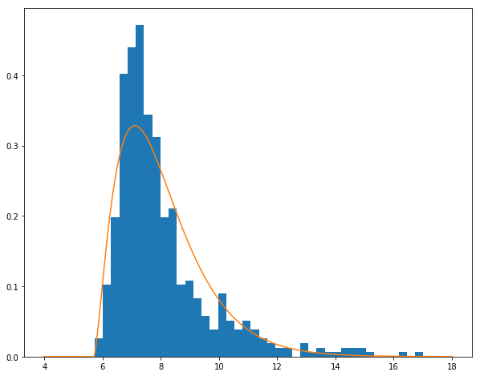
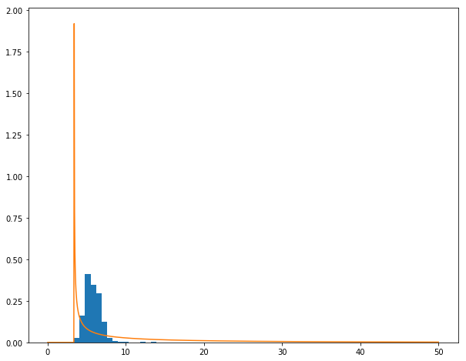
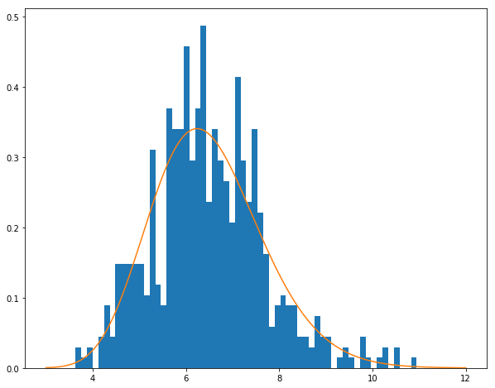
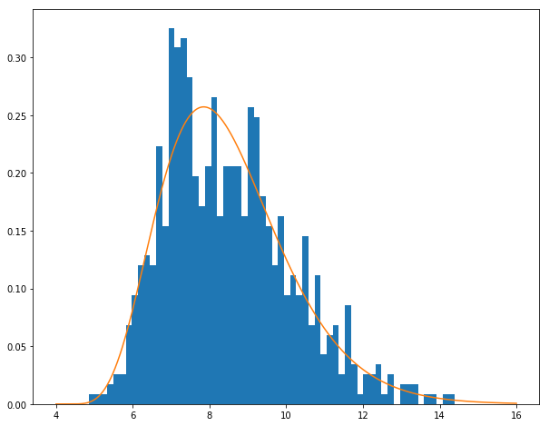
Gamma vs Histogram of Travel Time
Morning Peak
x axis – travel time
Mid-day Peak
x axis – travel time
Evening Peak
x axis – travel time
Night time Peak
x axis – travel time

Slide 9
K-S Test for Observed and Theoretical Travel Time Distribution
Test for Log Normal Distribution
Time of the Day | Statistic | p-Value | Result
Morning Peak (6 am to 9 am) | 0.05185 | 0.09764 | Not Rejected
Mid-day Peak (9 am to 3 pm) | 0.05013 | 0.00855 | Rejected
Evening Peak ( 3 pm to 6 pm) | 0.03557 | 0.47942 | Not Rejected
Night-time Peak (6 pm to 10 pm) | 0.04289 | 0.13002 | Not Rejected
Test for Gamma Distribution
Time of the Day | Statistic | p-Value | Result
Morning Peak (6 am to 9 am) | 0.086879 | 0.00043 | Rejected
Mid-day Peak (9 am to 3 pm) | 0.38379 | 0.0 | Rejected
Evening Peak ( 3 pm to 6 pm) | 0.03658 | 0.44194 | Not Rejected
Night-time Peak (6 pm to 10 pm) | 0.04177 | 0.14953 | Not Rejected

Slide 10
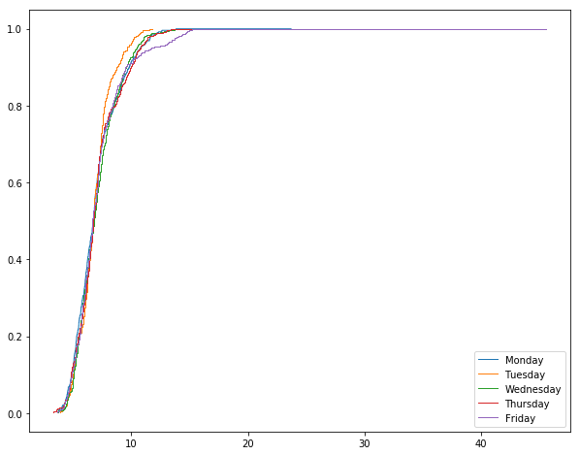
Evaluation of LOS of the Corridor using Momentum based Reliability
Weekdays | 50th Percentile Speed | 85th Percentile Speed
Monday | 18.9870143764 | 13.9944766387
Tuesday | 19.5368058049 | 15.7939929967
Wednesday | 18.7879173218 | 14.1917239226
Thursday | 18.9701198746 | 13.9104659132
Friday | 19.2376592721 | 14.4700534145
Cumulative Percentage
Figure: Average travel time for the corridor

Slide 11
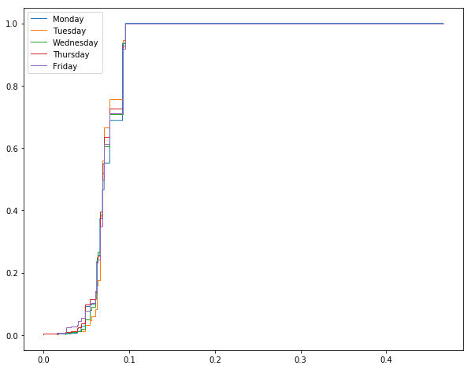
Momentum based Reliability (CONT.)
Cumulative Percentage
Figure: Coefficient of Variation of the travel time

Slide 12
Percentile based Reliability
Time of the day | LOS | Average Speed | Travel Speed | TTI | BI
AM peak | F | 16.5 | 7.5 – 22.5 mph | 3.76 | 42.26%
Mid day peak | F | 22.7 | 2.8 – 38.1 mph | 2.75 | 26.6%
Evening peak | F | 20.5 | 11.7 -35.3 | 3.03 | 32.5%
Night peak | F | 15.7 | 8.9 – 24.5 mph | 3.97 | 16%
*LOS estimated based on HCM 2010

Slide 13
Summary
As BI gives more indication of travel time variability, BI and TTI are not showing any specific correlation for that corridor with LOS F.
The night time (between 6 pm to 10 pm) scenario shows reliable longer journey in a congested situation based on TTI and BI.
The midday (between 9 am to 3 pm) scenario shows a reliable short travel time based on TTI and BI.
During Thursday, the LOS is comparatively better than other days depicted by cumulative distribution and percentiles speed.

Slide 14
Future Steps
Data for an entire 1 year period is needed to more accurately perform test. However, DiDi data provides 30 days data.
Analysis should be carried on several segments in stead of one to compare the LOS.
Assessment of LOS can also be done for two directional major roadways to make it more robust.

Slide 15

QUESTION??

